Slide 1
All about Ms. Gillum!
Living in Color!

Slide 2
What’s up with Ms. G?
I was born in ___________ ___________, where it is COLD in the winter. Many people celebrate New Year’s Eve in this state!
I am the oldest of four children. Because my dad played professional baseball when I was a kid, my siblings and I were all born in different states!
I love baseball, volleyball, shopping, vacationing at the beach, and Starbucks! And the Aggies, of course!
I have taught for 31 years! Can you guess how old I am? Prizes for those who guess correctly!
I have taught in the Klein, Wichita Falls, and Bryan independent school districts
QUESTIONS???

Slide 3
My daughters…Bailey and Brady
Bailey is 22 and attends SHSU where she is studying to be a TEACHER!
Brady is 16 and attends CSHS where she plays volleyball!

Slide 4
Bailey!

Slide 5
Smiles!

Slide 6
Brady!

Slide 7
More smiles!

Slide 8
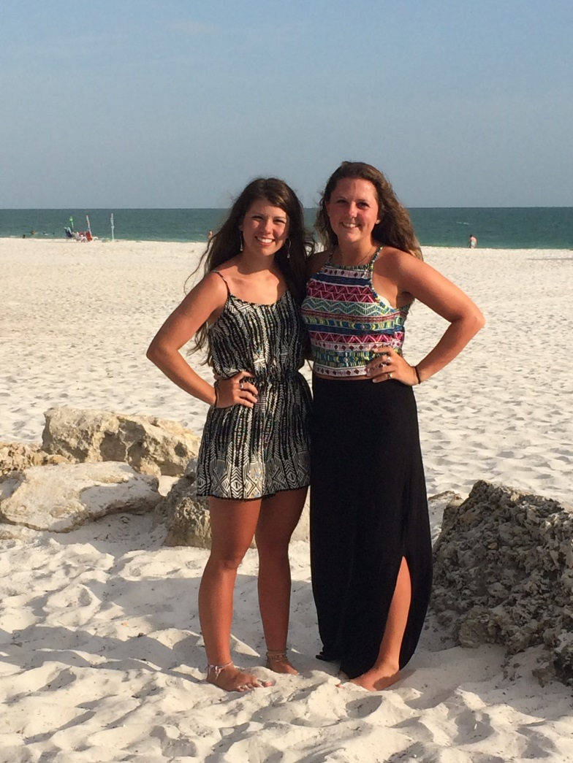
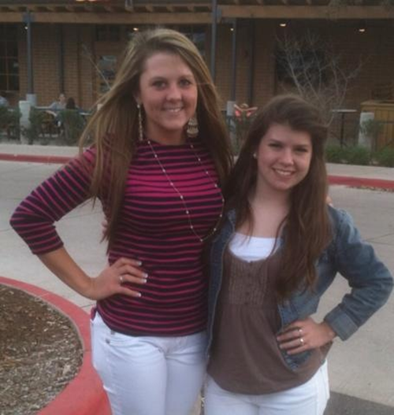
Love my girls!

Slide 9
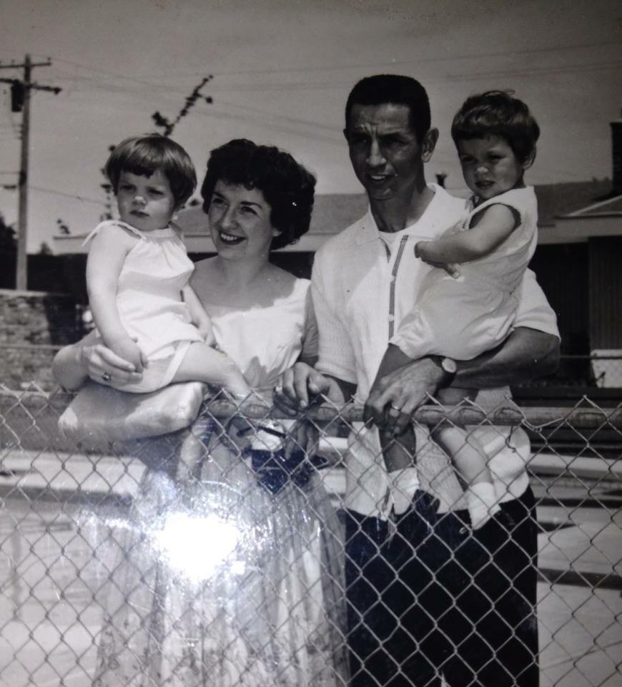
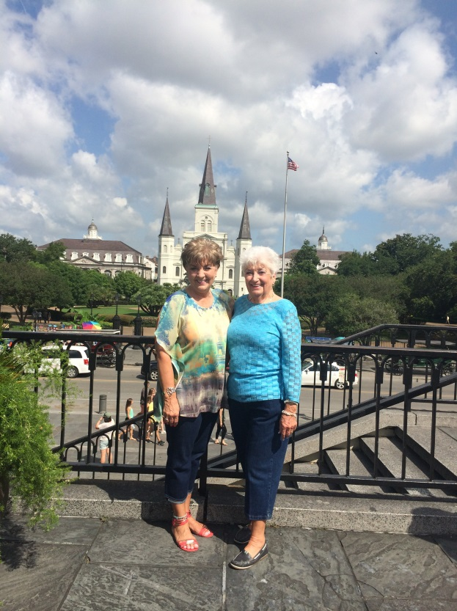
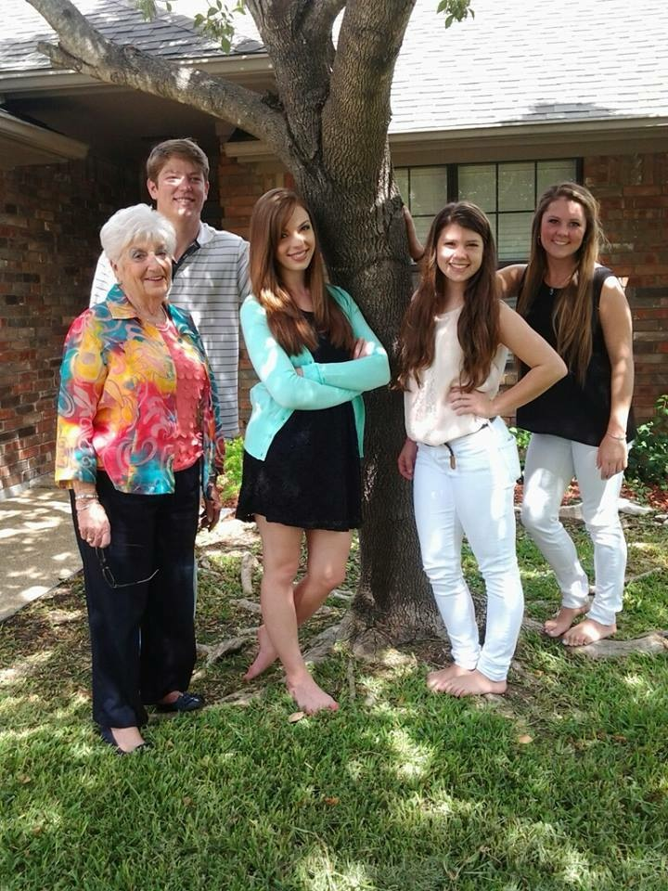
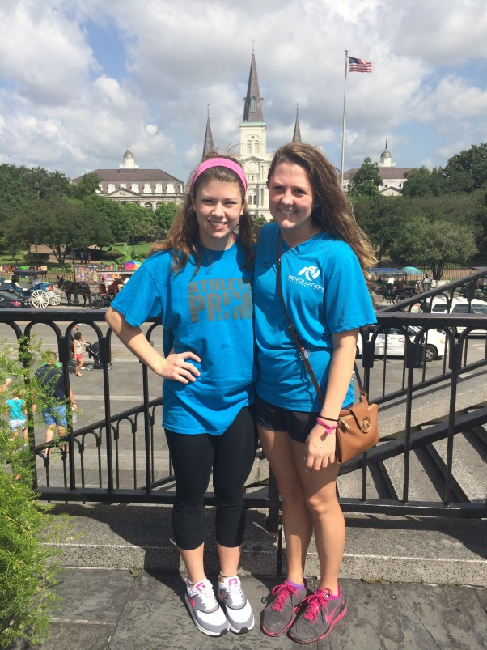
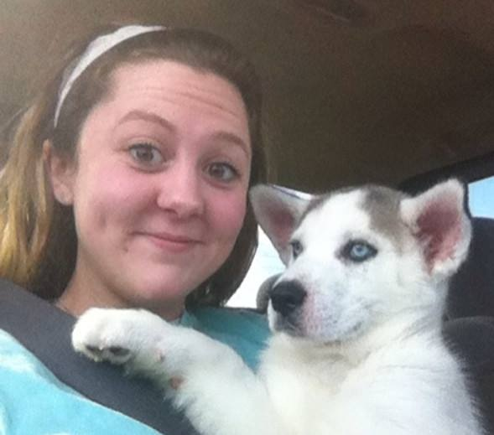
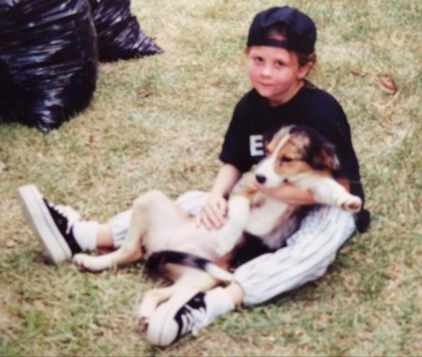
More family!

Slide 10
I AM GLAD YOU ARE HERE! THE CLASS OF 2020 ROCKS!!

